Slide 1
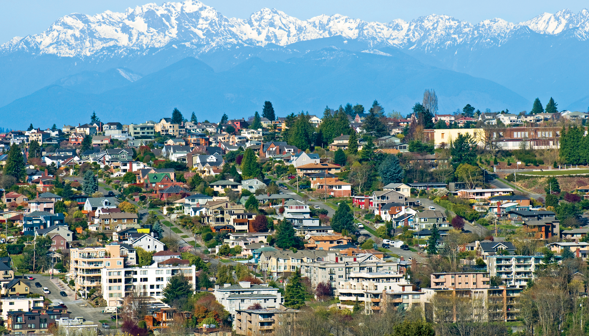
Housing Price Prediction
Kings County, Washington
Bobby Williams & Clair Marie Wholean

Slide 2
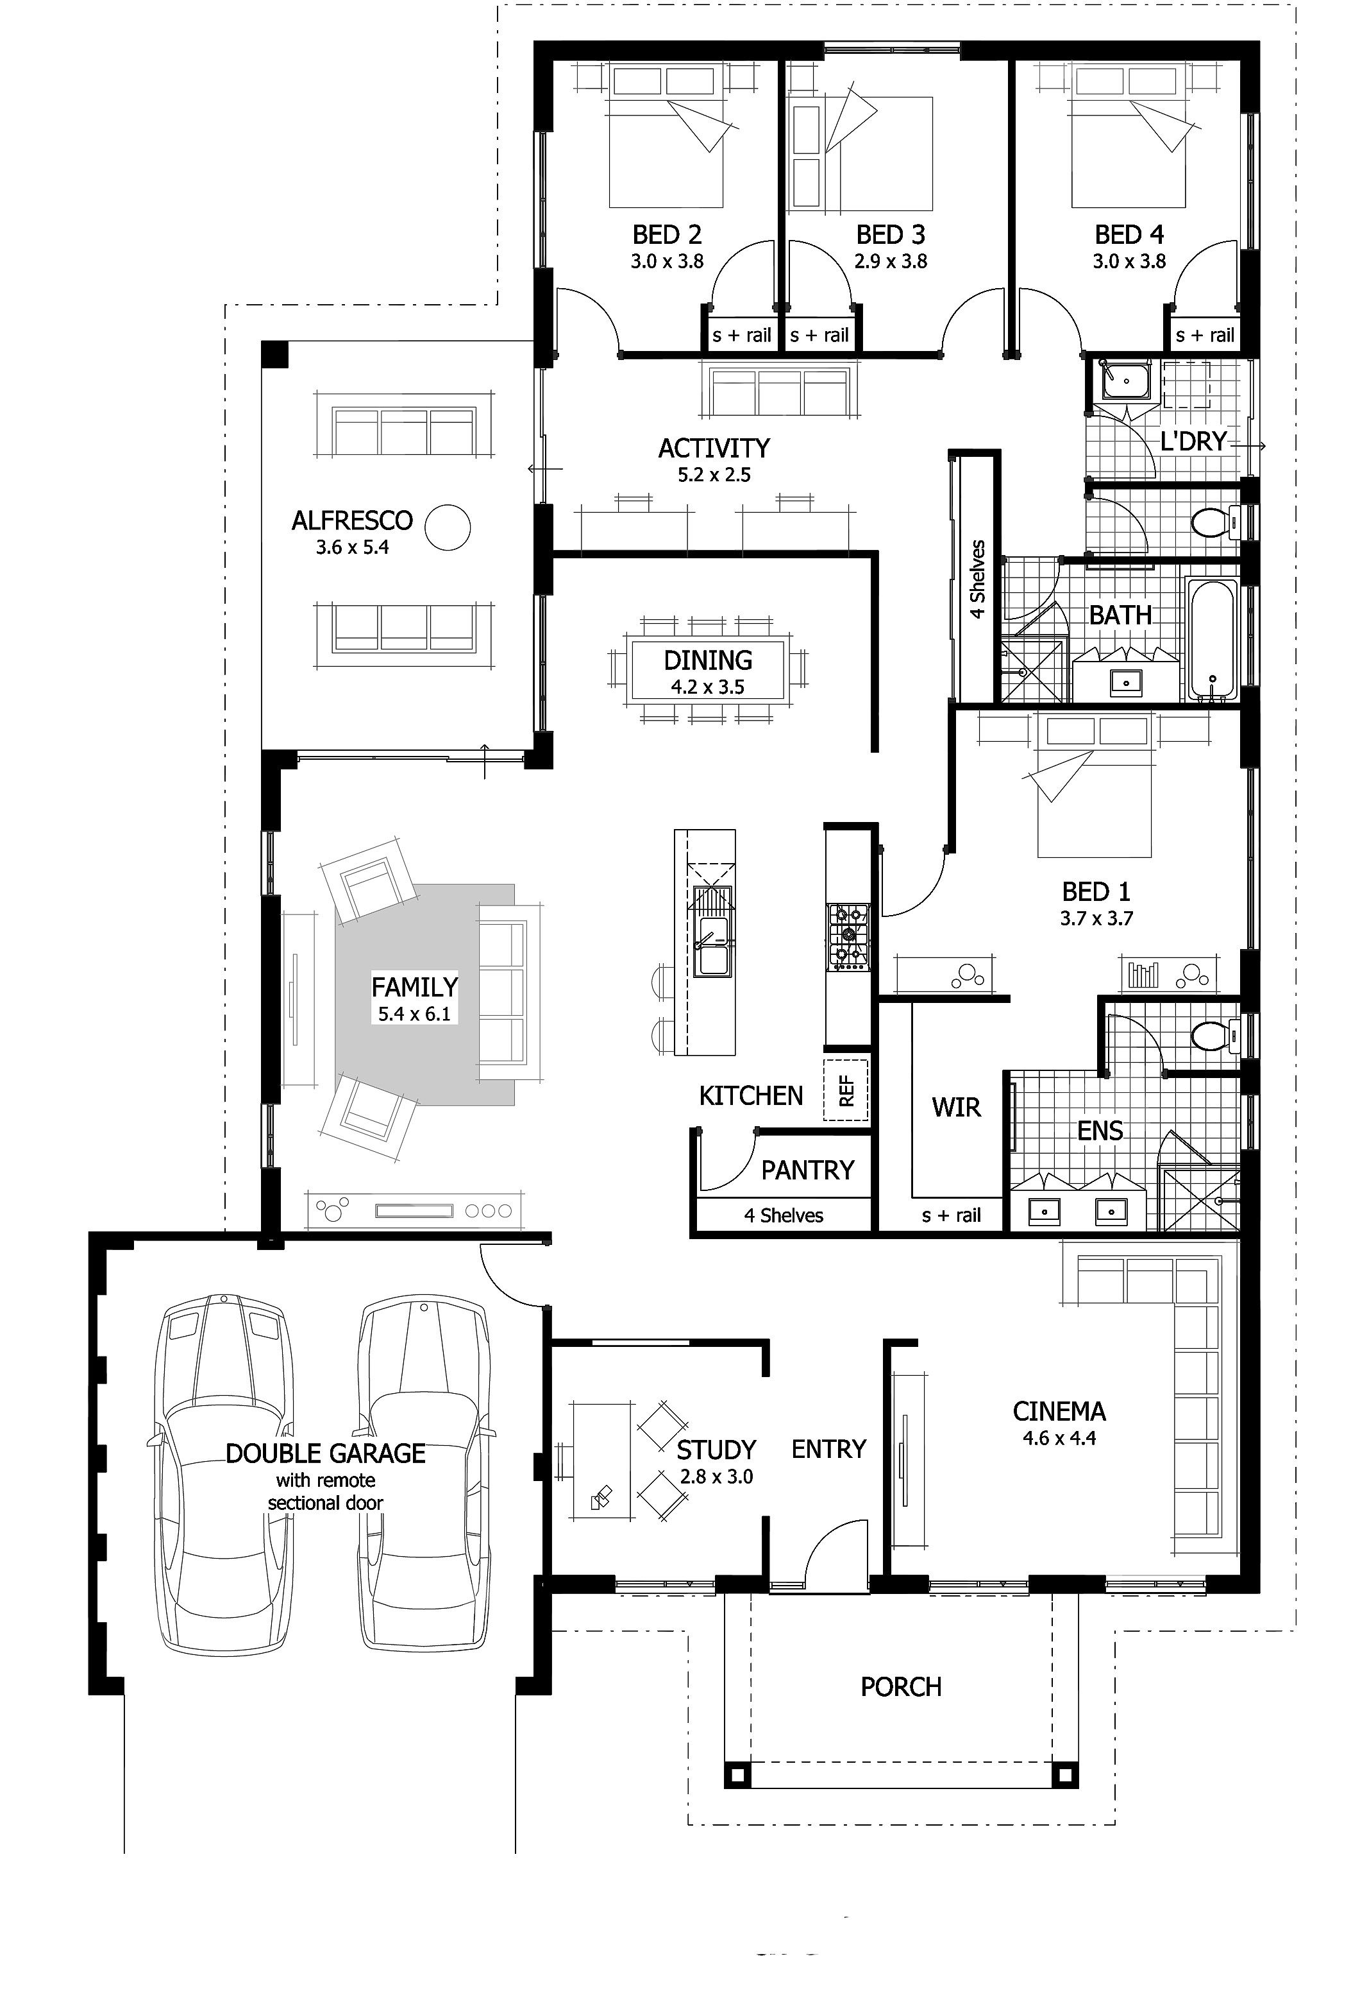
Key Questions
Which features predict the price of a home, and by how much?
Does density, as defined by the ratio of living area to lot area, affect house price?
What is the difference in price between urban and non-urban homes?

Slide 3

Data & Assumptions
King County Washington Housing Data Set
Single-family only
Location has a major impact on price, this study looks at other features.
18,000 houses

Slide 4
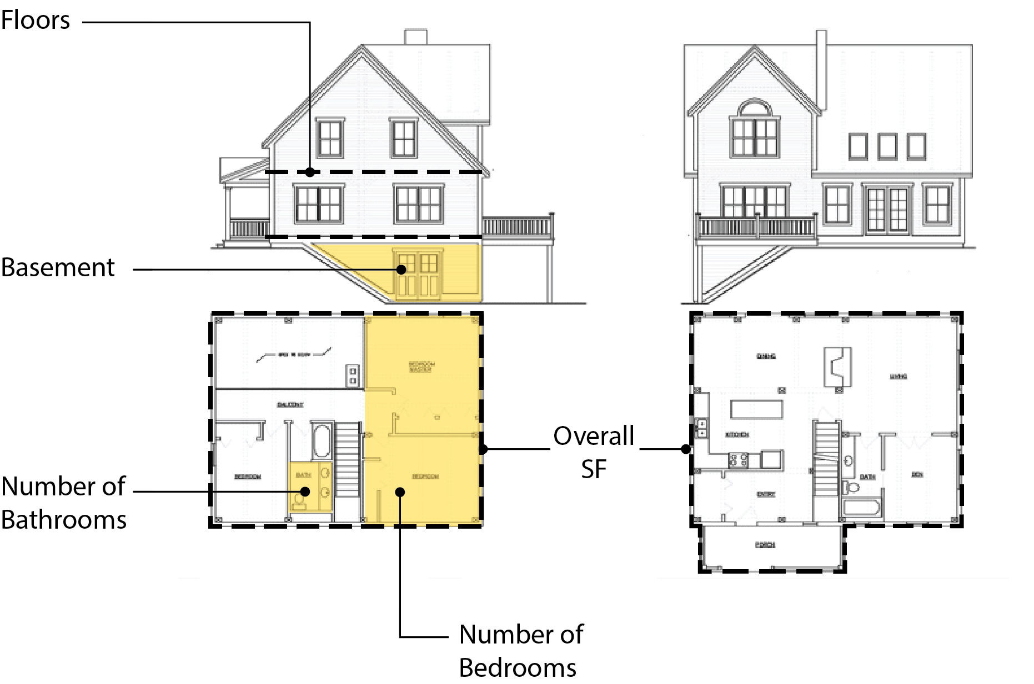
Variables Considered

Slide 5
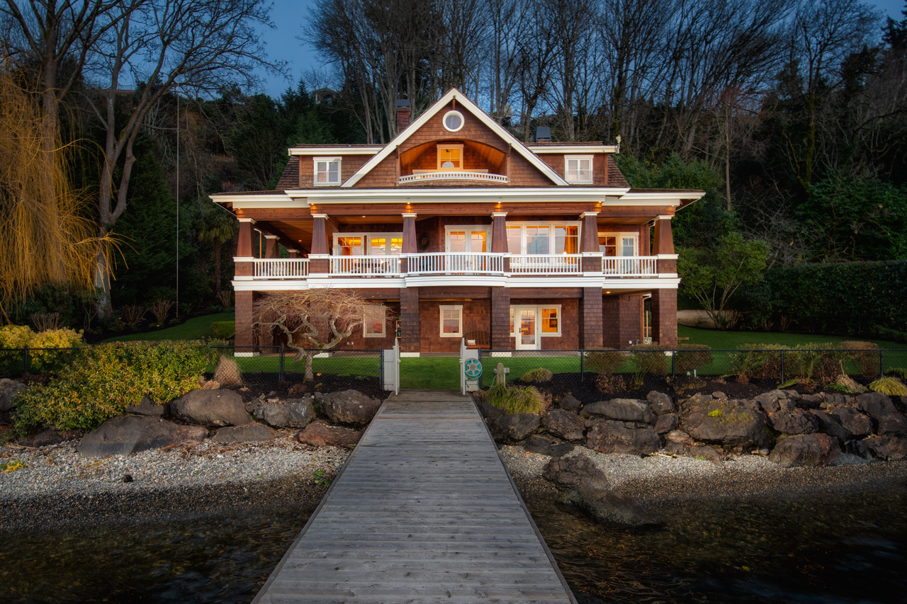
Waterfront Homes
A waterfront home is worth $814,000 more than a non-waterfront home.

Slide 6
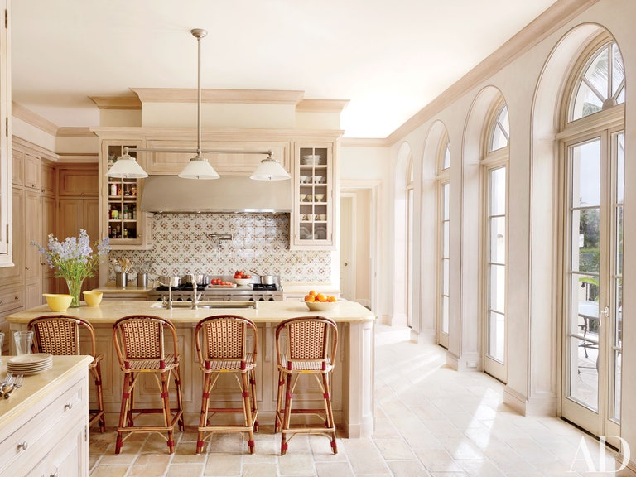
Recently Renovated
A recently renovated home is worth $153,000 more than a non-renovated home.
Recent defined as renovated after 2000.

Slide 7
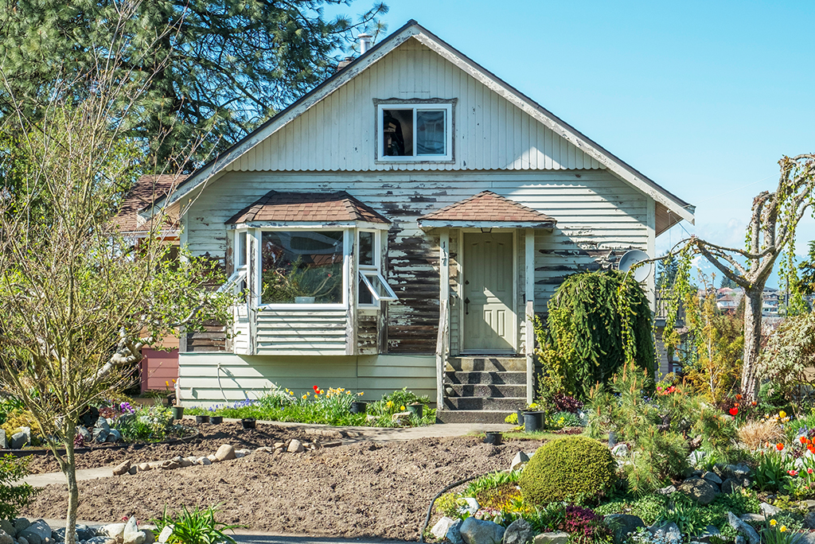
Overall Condition
Homes in good condition worth $36,700 more than homes needing repairs.

Slide 8
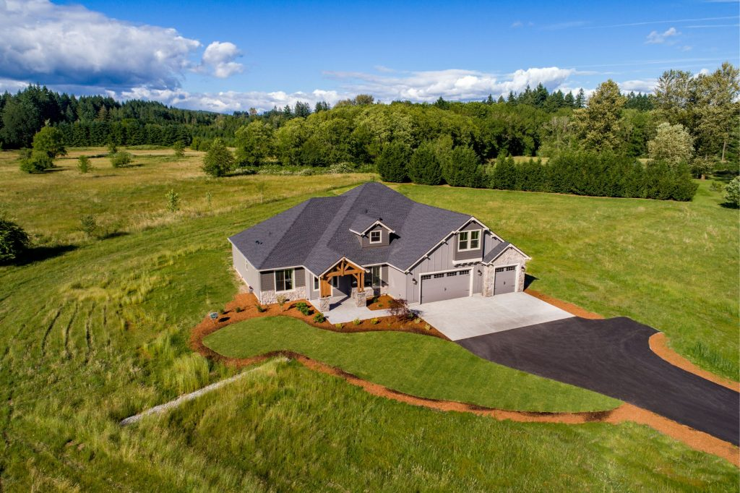
Lot Density
The ratio of total SF / lot SF.
Low density - baseline
Mid-density + $18,000
High Density + $119,000

Slide 9
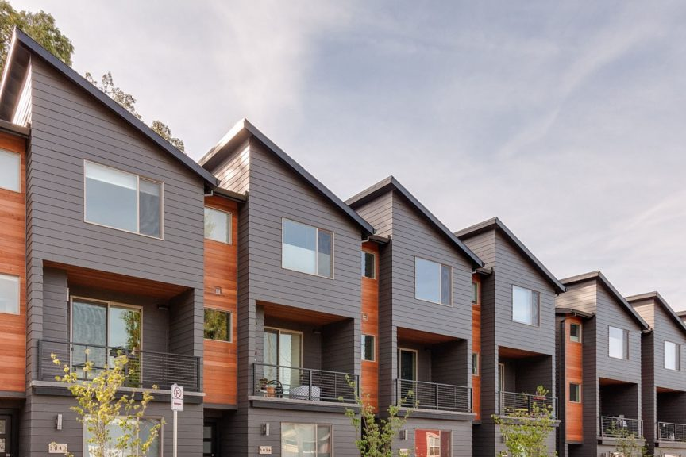
Urban vs. Non-urban
An urban home is worth $144,000 more than a non-urban home.

Slide 10


Overall SF
Lot
SF
Basement SF
For each additional 100 SF, the house price goes up by $25,000.
For each 1,000 SF added to the lot, the price goes down $263
For each 1,000 SF of basement, the price goes down by $19,450.

Slide 11



Floors
Bedrooms
Bathrooms
For each additional floor, the house price goes down by $42,000.
2-3 bedrooms is ideal. The price goes down with 3+ bedrooms.
For each additional bathroom, the house price goes up by 17,600

Slide 12
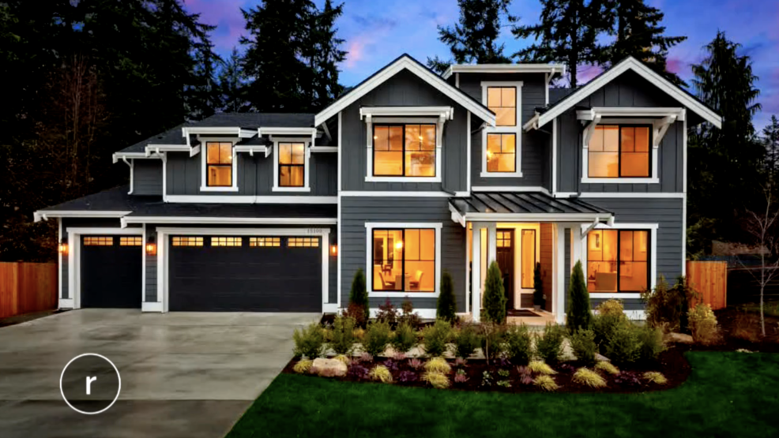
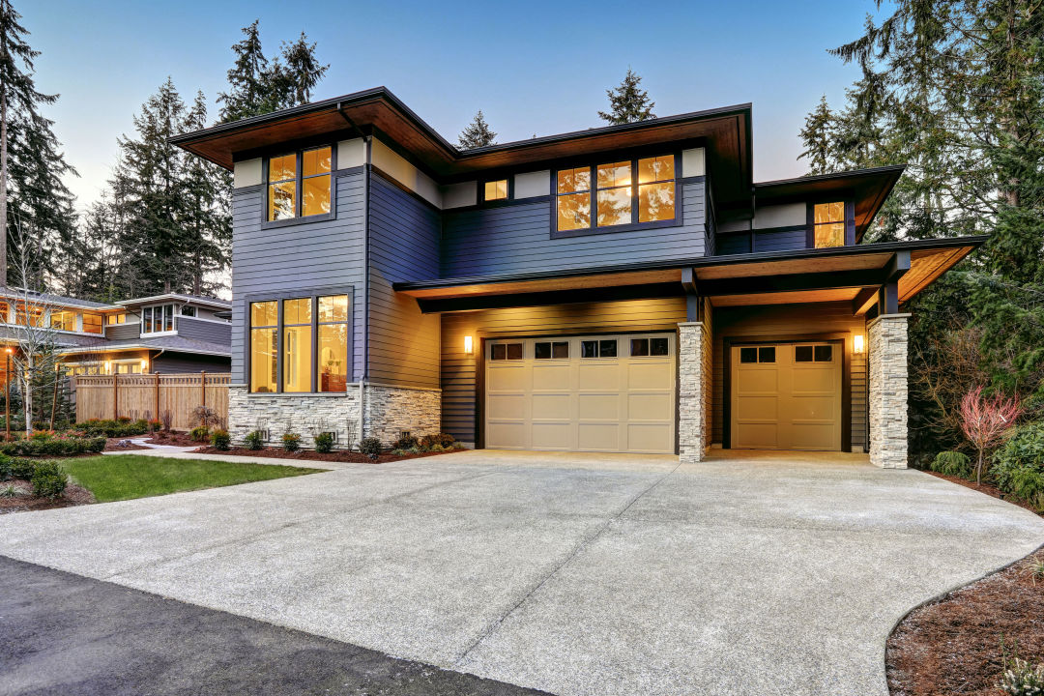
Predictions
Scenario 1: 1.75 bath, 1880 sf, 48787 sf lot, 2 floors, not waterfront, no basement, good condition, not renovated, rural, low density, 4+ beds.
$333,000
Scenario 2: 3.25 bath, 3030 sf, 9273 sf lot, 2 floors, not waterfront, no basement, good condition, not renovated, rural, low-density, 4+ beds.
$762,340

Slide 13
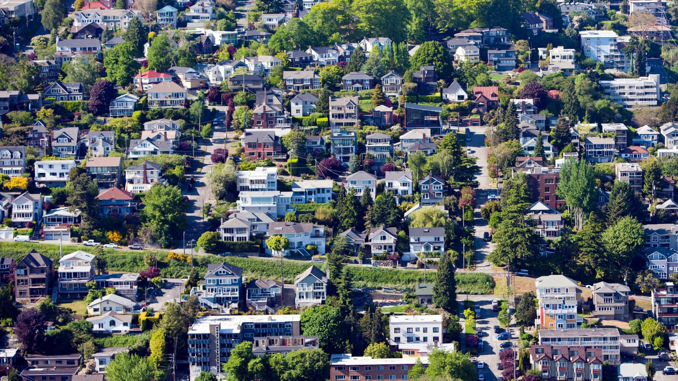
Further Study
Suburban homes
Predictions by zip code
Housing Affordability

